Slide 1
Module-3
Schema Refinement

Slide 2
Schema Refinement
Guidelines for the Relational Schema
Normalization
Boyce Code Normal form
Multi valued dependency and Fourth Normal form
Join dependency and Fifth Normal form

Slide 3
Informal Design Guidelines for Relational Databases
What is relational database design?
The grouping of attributes to form "good" relation schemas
Two levels of relation schemas
The logical level
The storage "base relation" level
Design is concerned mainly with base relations
What are the criteria for "good" base relations?

Slide 4
Good Design
Can we be sure that a translation from EER-diagram to relational tables results in good database design?
What is good database design?
Four informal measures
Formal measure: normalization
Notes:
The four informal measures are:
Semantics of the attributes (it is straightforward to understand why the attribute is in the relation, putting department data in the EMP-table is for example not straightforward)
Reducing redundant information in tuples (it is always good design to have a database that is small on disk and in memory, thus any reduction of redundancy is – in this sense! – good. But there is also a problem WITHIN the database if there is redundant information. Redundancy means that the same information is stored twice. If that is so in a database, so-called update anomalies can occur:
EMP(EMPID, EMPNAME, DEPTNAME, DEPTMGR)
Insertion anomaly: if the EMP table also contains DEPT-info, the insertion of a new employee must contain correct, consistant DEPT-information.
Deletion anomaly: If the last employee of the department is deleted, all department information is lost.
Modification anomaly: If a department receives a new manager, all employee tuples need to be updated with that information.
Reducing NULL values in tuples (not so big issue really)
Why is the attribute there in the first place if almost every tuple has a NULL-value for it? Unclear semantics.
Storage is not really a problem in today’s databases
But it is very costly to have joins on such columns because the NULL-value must be taken into account with an OUTER join which is a very expensive operation.
Disallowing the possibility of generating spurious tuples
Figure 10.5 in the book has a horrible schema where EMP_LOCS(ENAME, PLOCATION) is joined with EMP_PROJ1(SSN, PNUMBER, HOURS, PNAME, PLOCATION) on PLOCATION resulting in a cross-product with spurious (incorrect) tuples.
Only join on foreign key/primary key-attributes.
The answer to the first question is actually: Well, yeah, at least we can be quite confident!
Normalisation brings relations from bad design to good design with regards to redundancy.
On the one side, there is the flat relation R(A1, A2, ..., AN), on the other side there could be N relations, each containing exactly one attribute. Normalisation finds a suitable balance between these extremes.

Slide 5
Schema Refinement
Informal Design Guidelines for Relational Schema
1.Semantics of the Attributes
2.Reducing the Redundant Value in Tuples.
3.Reducing Null values in Tuples.
4.Dissallowing spurious Tuples.

Slide 6
Schema Refinement
1.Semantics of the Attributes
Whenever we are going to form relational schema there should be some meaning among the attributes. This meaning is called semantics.
This semantics relates one attribute to another with some relation.

Slide 7
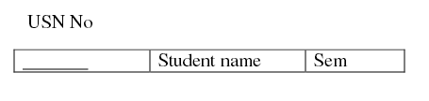
Schema Refinement
Informal Design Guidelines for Relational Schema
1.Semantics of the Attributes

Slide 8
1.1 Semantics of the Relation Attributes
GUIDELINE 1: Informally, each tuple in a relation should represent one entity or relationship instance. (Applies to individual relations and their attributes).
Attributes of different entities (EMPLOYEEs, DEPARTMENTs, PROJECTs) should not be mixed in the same relation
Only foreign keys should be used to refer to other entities
Entity and relationship attributes should be kept apart as much as possible.

Slide 9
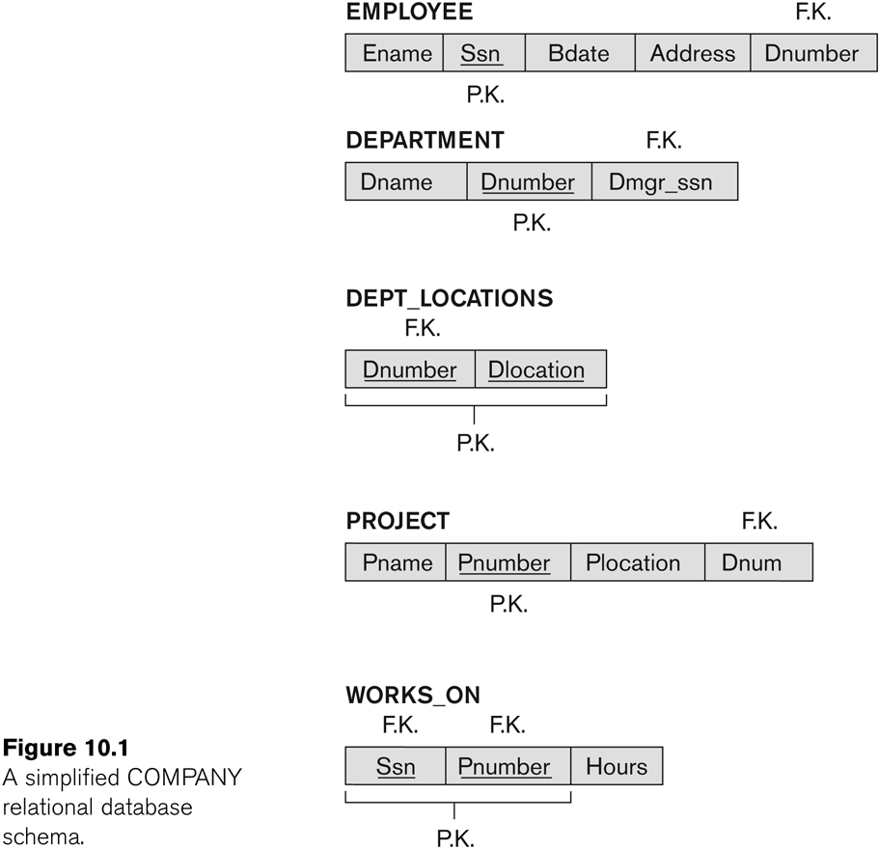
Figure 10.1 A simplified COMPANY relational database schema

Slide 10
Schema Refinement
2. Reducing the Redundant Value in Tuples
Storing the Same information redundantly, that is, in more than one place within a database, can lead to several problems:
Redundant Storage: Some information is stored repeatedly.
Problems with update anomalies
Insertion anomalies
Deletion anomalies
Modification anomalies

Slide 11

Schema Refinement
2. Reducing the Redundant Value in Tuples
If we integrate these two and is used as a single table i.e Student Table

Slide 12
Schema Refinement
Insert Anomalies
2. Reducing the Redundant Value in Tuples
Here whenever if we insert the tuples there may be ‘N’ students in one department, so Dept No, Dept Name values are repeated ‘N’ times which leads to data redundancy.
It may not be possible to store certain information unless some other, unrelated, information is stored as well.

Slide 13
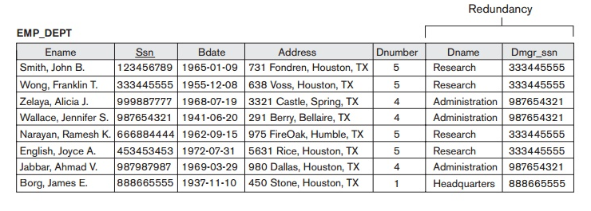

Slide 14
Schema Refinement
Delete Anomalies
2. Reducing the Redundant Value in Tuples
If we delete the last student of a dept, then whole information about that department will be deleted.
It may not be possible to delete certain information without losing some other, unrelated, information as well.

Slide 15
Schema Refinement
Modification anomalies
2. Reducing the Redundant Value in Tuples
If we change the value of one of the attributes of a particular table the we must update the tuples of all the students belonging to that dept else Database will become inconsistent.

Slide 16
Schema Refinement
3. Reducing the Null Values
Relations should be designed such that their tuples will have as few NULL values as possible
Attributes that are NULL frequently could be placed in separate relations (with the primary key )
Reasons for nulls:
Attribute not applicable or invalid
Attribute value unknown (may exist)
Value known to exist, but unavailable

Slide 17
Problems with null values
Waste of disk space
Problem of understanding the meaning of attributes
Problems in specifying JOIN operations
Problems in applying some aggregate functions
May have multiple interpretations (not applicable, unknown, unavailable)

Slide 18
Schema Refinement
Reasons for nulls:
The attribute does not apply to this tuple. For example, Visa_status may not apply to U.S. students.
The attribute value for this tuple is unknown. For example, the Date_of_birth may be unknown for an employee.
The value is known but absent; that is, it has not been recorded yet. For example, the Home_Phone_Number for an employee may exist, but may not be available and recorded yet.

Slide 19
1.4 Spurious Tuples
Bad designs for a relational database may result in erroneous results for certain JOIN operations
The "lossless join" property is used to guarantee meaningful results for join operations
GUIDELINE 4:
The relations should be designed to satisfy the lossless join condition.
No spurious tuples should be generated by doing a natural-join of any relations.

Slide 20
Functional Dependencies
A functional dependency is a property of the semantics of the attributes in a relation.
The semantics indicate how attributes relate to one another, and specify the functional dependencies between attributes. We illustrate this as:
A → B
Example: Suppose we keep track of employee name, and we only track one name for each employee. Suppose each employee is identified by their unique employee number. We say there is a functional dependency of employee name on employee number:
employee number → Employee name

Slide 21
Functional Dependencies
EmpNum
EmpEmail
EmpFname
EmpLname
123
jdoe@abc.com
John
Doe
456
psmith@abc.com
Peter
Smith
555
alee1@abc.com
Alan
Lee
633
pdoe@abc.com
Peter
Doe
787
alee2@abc.com
Alan
Lee
If EmpNum is the PK then the FDs:
EmpNum → EmpEmail
EmpNum → EmpFname
EmpNum → EmpLname
must exist.

Slide 22
Determinant
Functional Dependency
EmpNum → EmpEmail
Attribute on the LHS is known as the determinant
EmpNum is a determinant of EmpEmail
EmpEmail is a dependent

Slide 23
Functional Dependencies
EmpNum → EmpEmail
EmpNum → EmpFname
EmpNum → EmpLname
3 different ways you might see FDs depicted
EmpEmail
EmpNum
EmpFname
EmpLname
EmpNum EmpEmail EmpFname EmpLname

Slide 24
Transitive dependency
Transitive dependency
Consider attributes A, B, and C, and where
A → B and B → C.
Functional dependencies are transitive, which means that we also have the functional dependency A → C
We say that C is transitively dependent on A through B.

Slide 25
Transitive dependency
EmpNum → DeptNum
EmpNum EmpEmail DeptNum DeptNname
DeptNum → DeptName
EmpNum EmpEmail DeptNum DeptNname
DeptName is transitively dependent on EmpNum via DeptNum
EmpNum → DeptName

